Slide 1
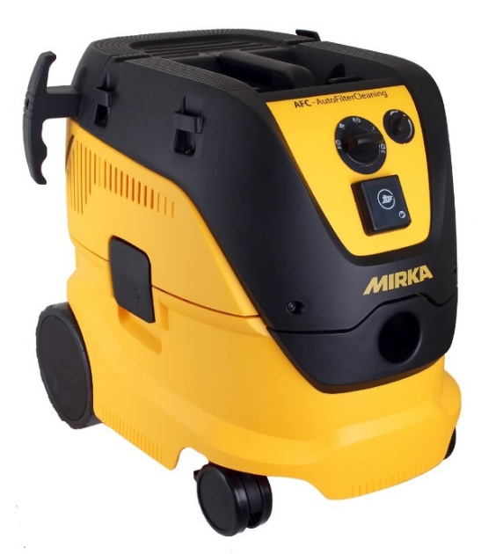
Mirka® Dust Extractor 1230
Launch Pack
October 2016

Slide 2
Content
Background and market information
Versions
Technical specifications and features
Accessories and trolleys
Comparison 915 vs. 1230
Pricing

Slide 3
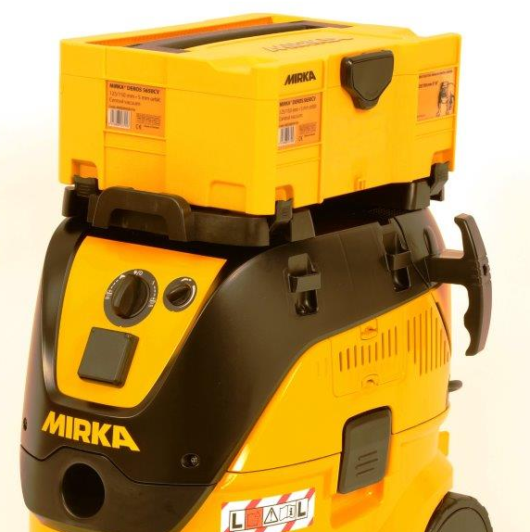
Background
New range will be launched October 2016, week 43 from European Distribution Center and in the beginning of November from Mirka Finland stock.
Many new great features, flat filter, AutoFilterCleaning, etc.
New possibilities to create system solutions thanks to the possibility to fasten Mirka cases on top of the dust extractor. Note that this requires an accessory.

Slide 4
Target applications
Relevant for all core business sectors: Wood, ART, OEM and CD
Offered L and M classes cover the majority of applications.
  Note that the end-user is responsible for choosing the correct dust extractor
AFC models, relevant in the cases when lot of dust is created to ensure that the filter is not getting clogged quickly. In addition it is also a ”fool-proof” option, no need to remember the manually clean filter.
AFC models can be used without dust bag, however dust bag is always recommended to keep working environment clean also when emptying the container + longer lifetime of the filter.

Slide 5
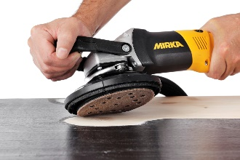
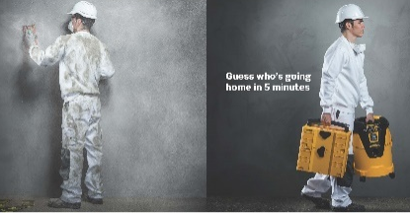

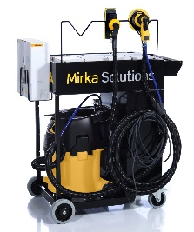
Market trends – Dust extractors
Mechanization of process
  Electric power tools and dust extractors
Health and safety
  Dust is recognized as health problem
  Dusty working environment requires more breaks
Automatic filter cleaning function
  Less maintenance
  Constant performance
  Possibility to work without dust bags
M-class increasingly important
  Stronger control from authorities that DE used is fit for purpose
  Follow up that correct dust extractor is used
  Still end-user is responsible that the correct dust extractor is used
System selling
  System selling where the dust extractor is the base
  Dust extractors used as work station

Slide 6
Total market development
Sales in Mio. €
Comments
Clear growing trend, one important reason is the growing focus on dust-free applications
Health and safety becoming increasingly important
Information on statistics:
- DIY and discount dust extractors not included
- Hand-held extractors not included
- Sources: GfK, VDMA and supplier’s internal research

Slide 7
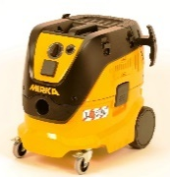
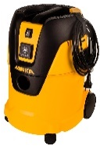
Total market development
Mirka range covers most application found in Mirka’s core business sectors
Mirka has products to cover 81 % of the dust extractor market

Slide 8
Content
Background and market information
Versions
Technical specifications and features
Accessories and trolleys
Comparison 915 vs. 1230
Pricing

Slide 9
European versions
Mirka® Dust Extractor 1230 L PC
  1200 W / 30 L container
  L-class
  Mirka code: 8999100111
Mirka® Dust Extractor 1230 L AFC (AutoFilterCleaning)
  1200 W / 30 L container
  L-class
  Mirka code: 8999200111
Mirka® Dust Extractor 1230 M AFC (AutoFilterCleaning)
  1200 W / 30 L container
  M-class
  Mirka code: 8999220111
Mirka will be able to offer a version of each model with the 4m hose included in the box, note that the code will then be different (BM or KIT).
Note that 915 M will remain 2017 in the range as a PushClean M-class version ensure that we can offer a relevant M-class dust extractor. Many end-users will prefer the AFC-version
The model name 1230 follows the same logic as model 1025:
  12 → 1200 W motor
  30 → 30 litre container

Slide 10
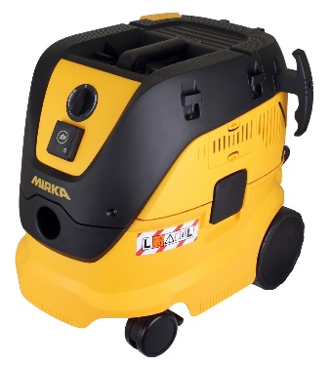
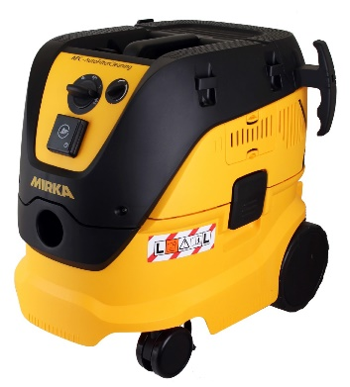
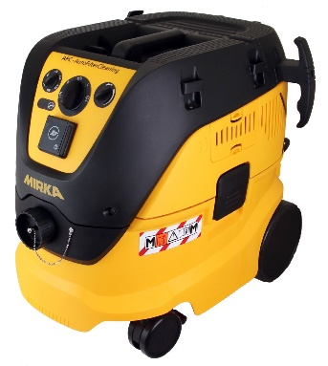

European versions
Existing model
Model | Target applications
1025 L PC Existing model | - Smaller surface - Compact model, easy to bring with you
1230 L PC | - Bigger surface - Basic version that requires manual filter cleaning
1230 L AFC | - Bigger surfaces - Applications where lot of dust is created, AutoFilterCleaning system cleans the filter regularly for better performance
1230 M AFC | - Bigger surfaces - Applications where a lot of dust is created, AutoFilterCleaning system cleans the filter regularly for better performance - Applications where materials requiring M-class dust extractor is required, e.g. hard wood, plaster

Slide 11
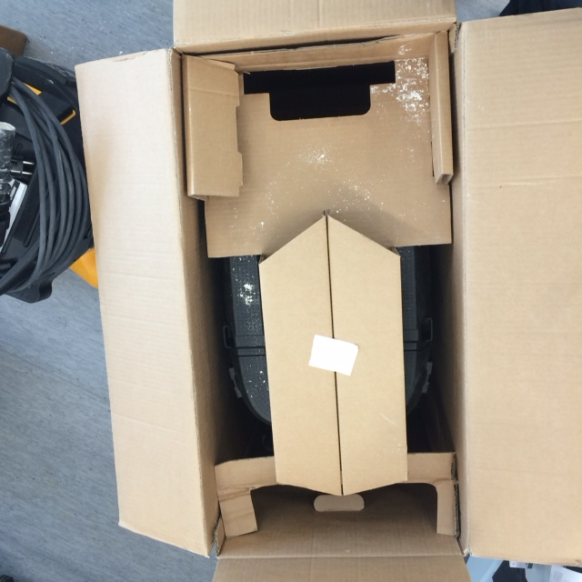
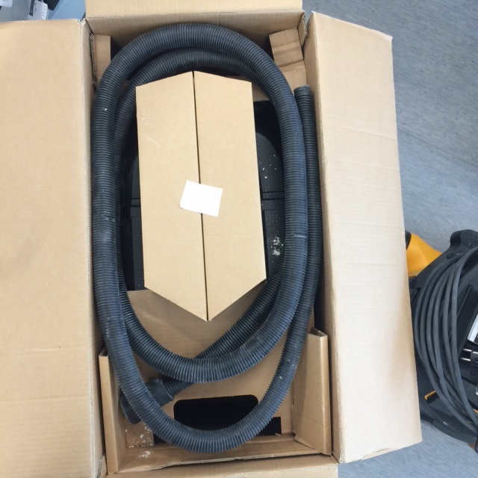
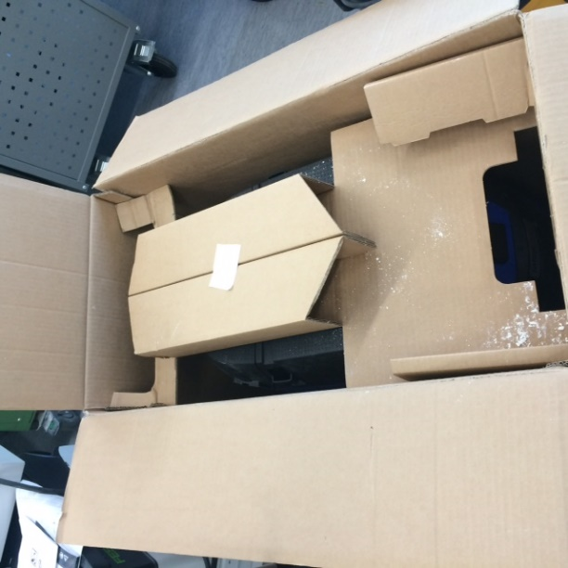
Possibility to order including 4 m hose into the box
We are able to offer the dust extractors also with hose included, the only hose that fits into the box is the 4m hose (MIN6519411)
Hose is added at Mirka warehouses in Finland and Belgium, dust extractors with hose included can be shipped to other warehouses. Note that the code will different from the Dust Extractor without hose.
  KIT1601ARMSF Mirka® Dust Extractor 1230 L PC + Hose
  KIT1602ARMSF Mirka® Dust Extractor 1230 L AFC + Hose
  KIT1603ARMSF Mirka® Dust Extractor 1230 M AFC + Hose

Slide 12
Content
Background and market information
Versions
Technical specifications and features
Accessories and trolleys
Comparison 915 vs. 1230
Pricing

Slide 13
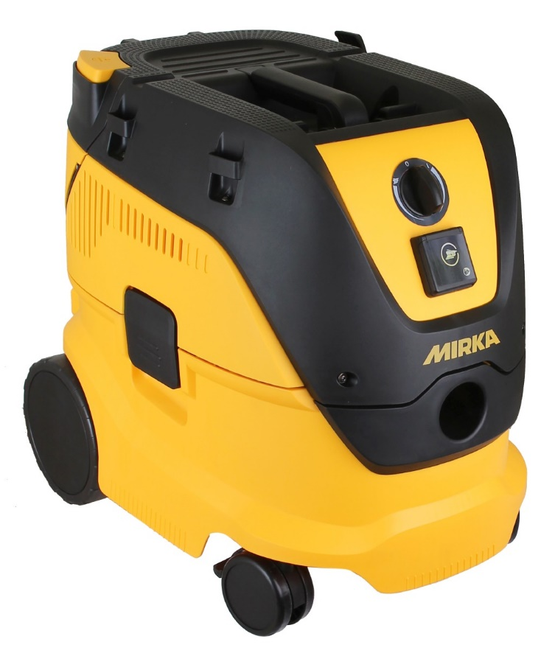

Technical features
L-class with Push & Clean filter cleaning
7.5 m rubber cable
High quality and long reach.
Cable storage
Durable strap keeping the cable in place during transportation. Simple and effective.
Hose storage - Basic
Keeps the hose ready for use and always in the same place as the dust extractor. Hooks on side only
Push & Clean filter cleaning
Easy way to clean the filter for longer life time and better performance
Flat top
Space for storage during usage, abrasives, radio, etc. Fastening loops enables end-user to secure stuff placed on top the dust extractor with rubber straps. Rubber straps not supplied by Mirka.
Easily accessible flat filter
Filter can easily be reached through separate opening in the back, no need to remove the complete upper part
Air intake filter
Longer life time of motor. For even better protection better (PET) filter available as accessory.
L-class
Proven performance for user protection
AutoStart function
Dust extractor runs only when power tool is running saves lifetime of dust extractor and less noise.
Large wheels
Important for easy manoeuvrability on floors that are not perfectly flat. Special attention has been paid to get front wheels fit for purpose.
High performance motor and turbine
1200 W motor and 1-stage turbine creates 250 mbar pressure and 4500 l/min airflow. Makes the dust extractor well suited for Mirka applications.

Slide 14


Technical features
L-class with Automatic Filter Cleaning
7.5 m rubber cable
High quality and long reach.
Cable storage
Durable strap keeping the cable in place during transportation. Simple and effective.
Hose storage – full version
Keeps the hose ready for use and always in the same place as the dust extractor
Easily accessible flat filter
Filter can easily be reached through separate opening in the back, no need to remove the complete upper part
Flat top
Space for storage during usage, abrasives, radio, etc. Fastening loops enables end-user to secure stuff placed on top the dust extractor with rubber straps. Rubber straps not supplied by Mirka.
Automatic Filter Cleaning
Keeps the filter automatically clean for better performance and longer lifetime. Function can also be de-activated every 15 second
Air intake filter
Longer life time of motor. For even better protection better (PET) filter available as accessory.
L-class
Proven performance for user protection
Easy usage
Main switch defines function and secondary switch speed.
Large wheels
Important for easy manoeuvrability on floors that are not perfectly flat. Special attention has been paid to get front wheels fit for purpose.
High performance motor and turbine
1200 W motor and 1-stage turbine creates 250 mbar pressure and 4500 l/min airflow. Makes the dust extractor well suited for Mirka applications.
AutoStart function
Dust extractor runs only when power tool is running saves lifetime of dust extractor and less noise.

Slide 15
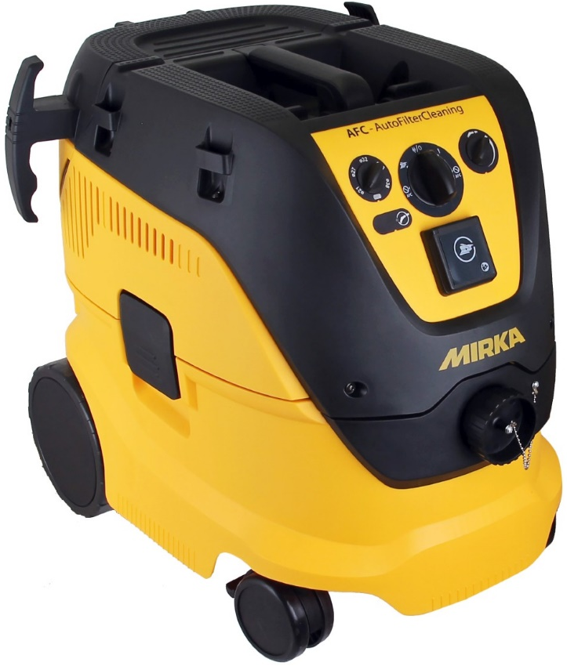
Technical features
M-class with Automatic Filter Cleaning
7.5 m rubber cable
High quality and long reach.
Cable storage
Durable strap keeping the cable in place during transportation. Simple and effective.
Hose storage – full version
Keeps the hose ready for use and always in the same place as the dust extractor
Flat top
Space for storage during usage, abrasives, radio, etc. Fastening loops enables end-user to secure stuff placed on top the dust extractor with rubber straps. Rubber straps not supplied by Mirka.
Easily accessible flat filter
Filter can easily be reached through separate opening in the back, no need to remove the complete upper part
Automatic Filter Cleaning
Keeps the filter automatically clean for better performance and longer lifetime. Function can also be de-activated every 15 second
Air intake filter
Longer life time of motor. For even better protection better (PET) filter available as accessory.
Easy usage
Main switch defines function and secondary switch speed.
M-class
Proven performance for higher user protection
AutoStart function
Dust extractor runs only when power tool is running saves lifetime of dust extractor and less noise.
Large wheels
Important for easy manoeuvrability on floors that are not perfectly flat. Special attention has been paid to get front wheels fit for purpose.
Air flow sensor
Indicates when air speed is below 20 m/s, which means that suction is not optimal and excess of dust might getting into the air. First LED illuminates and after few seconds audio signal starts. Hose diameter to be chosen so that the dust extractor knows what air flow to expect.
High performance motor and turbine
1200 W motor and 1-stage turbine creates 250 mbar pressure and 4500 l/min airflow. Makes the dust extractor well suited for Mirka applications.

Slide 16
Technical details
Mirka® 1230 L / M
Air flow | 250 m³/h (4500 l/min)
Sound pressure level ISO 3744,EN 60704-2-1 | 68 ±2 dB(A)
Sound level | 60 ±2 dB(A)
Power cord, length | 7.5 m
Tank volume | 30 l
Weight | 14.5 kg
Height | 565 mm
Width | 385 mm
Depth | 565 mm

Slide 17
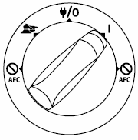
Automatic Filter Cleaning (AFC)
Filter is cleaned by change of airflow every 15 second
  For stronger cleaning block the airflow by the hose when filter cleaning is activated
Minimized loss of performance compared to other similar systems
Keeps the filter automatically clean for better performance and longer lifetime. It also enables usage without fleece bag. Can either be used without any bag or with a plastic disposal bag for easier emptying
Fleece bag still recommended in most case, not possible for concrete cutting applications
AFC function can be de-activated
Note that on the AFC models there will be power in the AutoStart socket even when the switch is 0-position
AutoStart + AFC
Manual on + AFC
AutoStart + AFC off
Manual on + AFC off

Slide 18



Classification of dust extractors
According to standards valid on the market dust extractors can be divided in different classes, most common classes are L(low) and M (medium). In addition there are also other classes for special applications, e.g. H (high).
Dust is a serious health issue and therefor it has been defined recommended exposure maximum limits for various types of dust in mg/m³ of air, these limits are the base for the different classes. The limit reflects the maximum dust concentration in the air where no health damage is expected during longer periods (8h/day, 5days/week). This means that lower exposure limit (mg/m³) means that the dust is more hazardous.
Different types of dust with different exposure limits requires different degrees of filtration in the dust extractor in order to ensure healthy working conditions. For example a hard wood typically has a maximum allowed dust exposure of ≥ 0.1 mg/m³ and therefor end-user needs to use a dust extractor that has a filtration system that is > 99,9 % (M-class)
Classification is not mandatory but classification is very important in order to ensure the end-user that the dust extractor is fit for the intended purpose.
Classification | Degree of filtration | Max exposure limit
 | > 99 % | > 1 mg/m³
 | > 99.9 % | ≥ 0.1 mg/m³
 | > 99.995 % | < 0.1 mg/m³
Standards are set by International Electro technical Commission (IEC) and European Committee for Standardization (CEN). Note that local regulations might overrule these standards .

Slide 19
Content
Background and market information
Versions
Technical specifications and features
Accessories and trolleys
Comparison 915 vs. 1230
Pricing

Slide 20

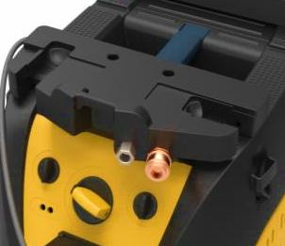
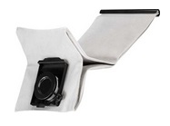
Accessories
Fastening system for Mirka Case
  Supports strongly Mirka system approach
  In addition Festool Systainers and Bosch L-boxx fit the same fastening system
Pneumatic box, more user-friendly, connectors in the front
Dust bags
  Fleece bags 5-pack
  Disposal plastic bags 5-pack
Filter element
Motor cooling filter (Air inlet filter)
  Standard, included with dust extractor at delivery
  PET, filter with better filtering capabilities
Trolley handle
Shelf system – still open

Slide 21

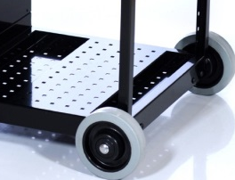
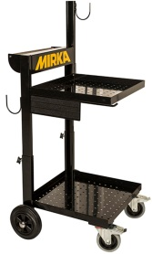
Trolleys
Solution trolley will be updated with an adapter that will make the dust extractor shelf slightly longer, implementation before the launch. The adapter will be available as separate item for end-users updating from 915 to 1230.
Dust extractor trolley accommodates Dust Extractor 1230 without modifications. No changes.

Slide 22
Content
Background and market information
Versions
Technical specifications and features
Accessories and trolleys
Comparison 915 vs. 1230
Competitive landscape
Pricing

Slide 23
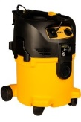



Comparison 915 vs 1230 1/2
Model 915 L/M | Model 1230 L/M | Comment
1-stage turbine, 250 mbar, 3 600 l/min | 1-stage turbine, 250 mbar, 4 500 l/min | Better performance, 25 % more airflow
Exchangeable carbon brushes | No exchangeable carbon brushes | No motor with exchangeable brushes available that would enable the improved performance
Wheel dimension: Front 60/Back 100 mm No brakes. | Wheel dimension: Front 75/Back 175 mm Front wheels with brakes. | Easier to use on uneven floors. Brakes on the front wheels.
No dedicated cable or hose storage | Practical hose and stage storage | Makes a difference everyday
Container 30 L + Cartridge filter | Container 30 L + Flat filter | +29 % in net volume, more effective usage of container volume
Filter material: PET material | Filter material: PET Nano-Fibre material | Better filtering properties
Two flat sealing gaskets on filter | One flat sealing gaskets on filter | Less risk for leakage
Manual cleaning | Automatic / Manual cleaning | Customer can choose automatic filter cleaning
Always to be used with fleece bag | Models with Automatic Filter Cleaning can be used w/o fleece bag. Plastic disposal for easier emptying is available. | It is recommended to use fleece bag to keep the dust extractor cleaner → longer lifetime of the filter.
M-class: slow start of AutoStart | AutoStart on L- and M-class will be as fast as 915 L | Less dust in the air when starting to work

Slide 24
Comparison 915 vs 1230 2/2
Main selling points, 915 L P&C vs 1230 L P&C:
  Higher performance, 3 600 l/min → 4 500 l/min → 25 %
  Higher net volume of the container due to flat filter, → 29 %
  Easier everyday use, no storage options → dedicated places for hose + cable
  And many more selling points in the previous slide
AutoFilterCleaning (AFC) versions technically and practical different types of products and therefore it is more obvious why there is a price difference to
915 L / M

Slide 25

Cross selling
Fleece dust bags
  New size of dust bag needed on the market, Mirka will be among the first to present versions from the new platform
  In order to secure availability of the critical consumable it is required to sell 5 packs of dust bags (5 bags /pack) with each DE 1230
  Suggestion to cross selling:
  Mirka DE 1230 LPC + Case Fastening + Mirka Case high + Abranet P80
  4 packs x 50 pcs + Abranet HD P60 2 packs x 25 pcs

Slide 26
Content
Background and market information
Versions
Technical specifications and features
Accessories and trolleys
Comparison 915 vs. 1230
Pricing

Slide 27
Pricing - European versions
Mirka® Dust Extractor 1230 L PC
  1200 W / 30 L container
  L-class
  Gross price: EUR 515,00/pc, discount according to usual discount for machines
  Mirka code: 8999100111
Mirka® Dust Extractor 1230 L AFC (AutoFilterCleaning)
  1200 W / 30 L container
  L-class
  Gross price: EUR 650,00/pc, discount according to usual discount for machines
  Mirka code: 8999200111
Mirka ® Dust Extractor 1230 M AFC (AutoFilterCleaning)
  1200 W / 30 L container
  M-class
  Gross price: EUR 870,00/pc, discount according to usual discount for machines
  Mirka code: 8999220111

Slide 28
Accessories pricing
Mirka code | Product | Gross price
8999100211 | Dustbag Fleece for DE 1230, 5/Pack | 61,75/ pack
8999110311 | Disposal Dustbag for DE 1230, 5/Pack | 64,90/pack
8999100411 | Filter for DE 1230 | 72,50/pc
8999101011 | Pneumatic Box for DE 1230 230V | 209,00/pc
8999110111 | Motor Cooling Filter for DE 1230 | 11,05/pc
8999110211 | Motor Cooling Filter PET for DE 1230 | 31,20/pc
8999110411 | Case Fastening Accessory for DE 1230 | 28,70/pc
Discount on accessories, according to discount for abrasives
Availability still open:
  Trolley handle

